Slide 1

Forecasting the Prices of Agriculture Commodities

Slide 2



Sharat Manikonda
Director at Innodatatics and Sponsor
linkedin.com/in/sharat-chandra
Raju G
linkedin.com/in/raju-gulla

Slide 3

















Team
Barkha Khatri
Lekha G
Vicky Singh
Vamshi Bhongiri
Shubham Undirwade
https://www.linkedin.com/in/barkha-khatri-190bb420b/
https://www.linkedin.com/in/lekha-g-695593b3
https://www.linkedin.com/in/ivickysingh/
https://www.linkedin.com/in/vamshi-bhongiri-69305815b/
https://www.linkedin.com/in/shubham-undirwade-157782b4
Panchanand Jha
Mallipuram Kiran
Ayesha Siddiqha
Anandakrishnan Kv
Vigneshsaimay
https://www.linkedin.com/in/ikiranmallipuram
https://www.linkedin.com/in/ayesha-siddiqha-52a4821aa/
https://www.linkedin.com/in/panchanand-jha-7767674b/
https://www.linkedin.com/in/anandakrishnan-kv-01597612b
https://www.linkedin.com/in/vigneshsaimay1/

Slide 4













Team
Amit Kumar
Hemanth D
Vibhuti Nagaich
Upadhyay Sachin
Pratiksha chavan
https://www.linkedin.com/in/amit-kumar-789bba147/
https://www.linkedin.com/in/hemanth-d-17101b20a/
https://www.linkedin.com/in/vibhuti-nagaich-a691b090
https://www.linkedin.com/in/usachin61/
https://www.linkedin.com/in/pratiksha-chavan-68551b173/
Heeba Shaik
Prashanth Daya
Senthilnathan S
Lokeshwari Kondaru
https://www.linkedin.com/in/heeba-shaik/
https://www.linkedin.com/in/senthil-nathan-s
https://www.linkedin.com/in/kondaru-lokeshwari-4082101ab
Kritek choudhary
https://www.linkedin.com/in/prashanth-daya-081180197
https://www.linkedin.com/in/kritek-choudhary-067400b8

Slide 5
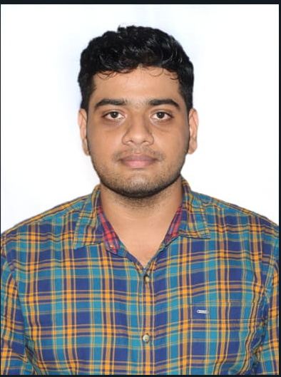


Team
Snajay Khadanga
Sharannbasappa cm
Bhaskar Kosike
Silpa Tadi
https://www.linkedin.com/in/sanjaya-khadanga-b288b9102
https://www.linkedin.com/in/sharannbasappa-cm-33687017a
https://www.linkedin.com/in/bhaskar-kosike-3815a91b0
https://www.linkedin.com/in/silpa-t-22b535221/

Slide 6
Project Goals and Constraints
To demonstrate the basic information of markets, varieties and grades of various commodities.
Analysing the price dependencies of different commodities over time and locations of West Bengal.
Maximise the production of future demand commodity.
To predict best market price for the crops based on previous years.
To provide the forecasting of various commodities for given modal price.
Selections of different variety and grades of commodities with respect to market and its modal price.
Explain the role of prices in agricultural marketing within the frame work and behaviour of prices according to months.
Describe the concept of market integration with a focus on its analytical aspects,
Objectives
Constraints
Non-continuity in data.
Inadequate features for forecasting.
Collection of different commodities price in different markets and time span.

Slide 7
Data Analysis Pipeline
Business Understanding
Project Architecture
Data Collection
Data Understanding
Data Analysis and Forecasting
Dashboards

Slide 8




Technical Stacks

Slide 9
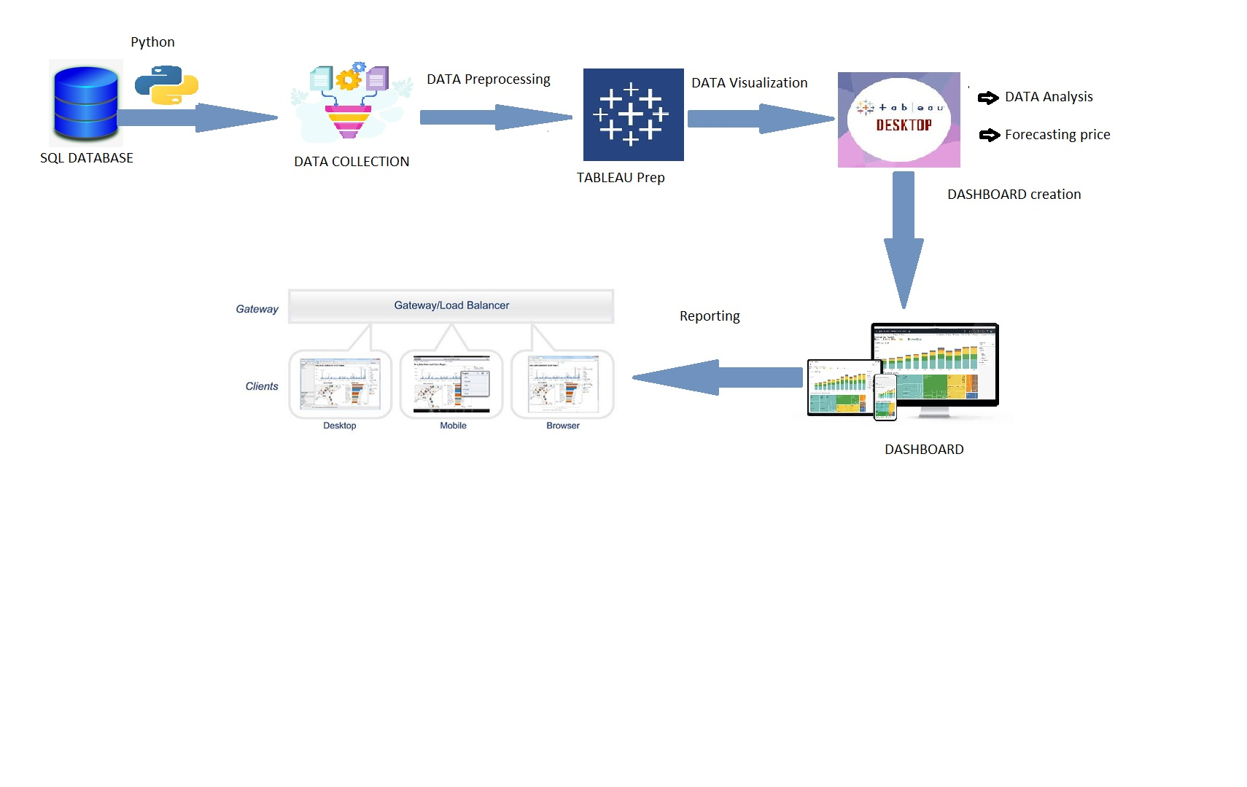

Project Architecture / Data Pipeline

Slide 10



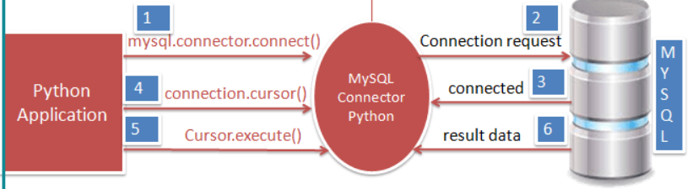
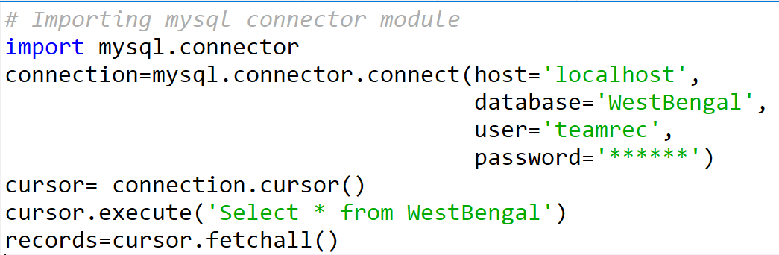
Data Collection
Extracting data from MYSQL and imported into python environment in .csv file format.
Module – mysql.connector
Select* - all columns
Fetchall() – all rows

Slide 11
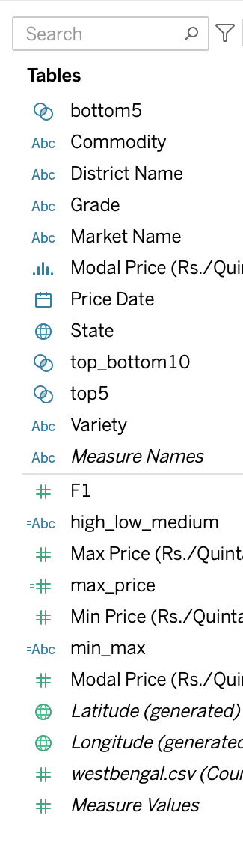
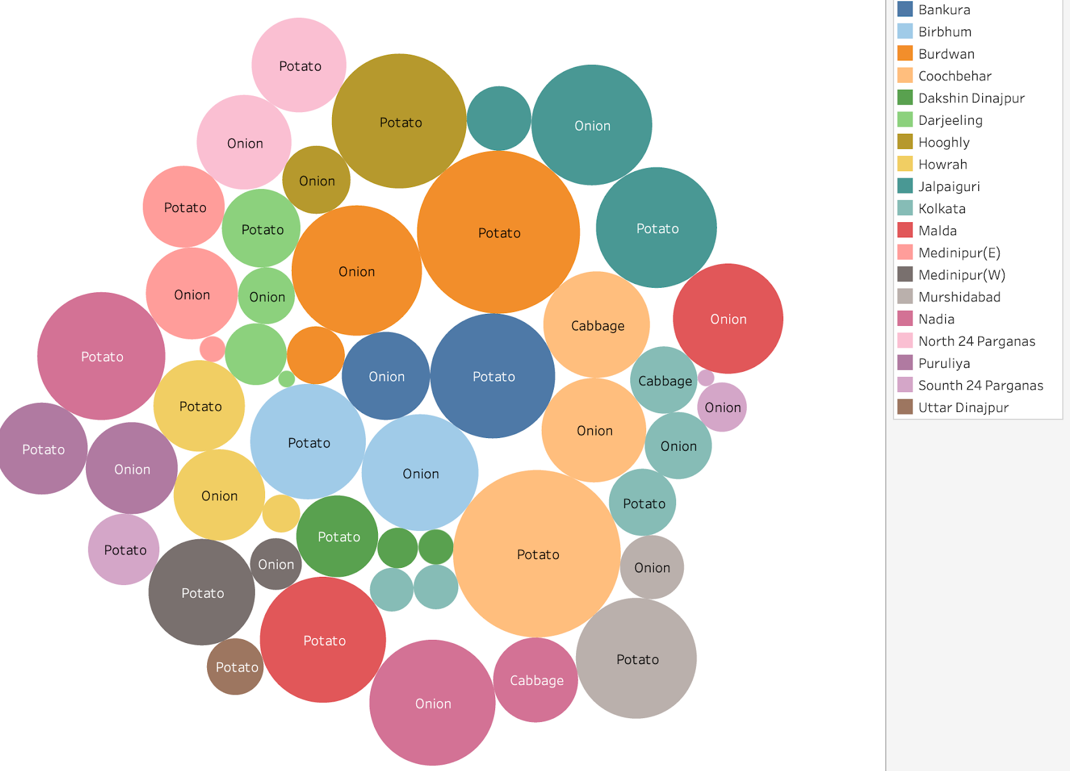
Data Understanding
Given west Bengal data was in csv format.
There are 11 columns and 43872 rows in the data.
The data is about the agriculture commodities prices (in Rs/quintal) of different markets of 19 districts of west Bengal in year 2020 and 2021.
There are 5 commodities in the data, namely Apple, Banana, Cabbage, Potato and Onion.
These commodities are further categorised in variety and grades.
There is maximum price, minimum price and modal price of the commodities and are given (in Rs./ quintal) for the different dates.
Modal price - Modal prices are average market prices for a particular commodity over a two-month period in Madhya Pradesh and two other states where the crop is grown and traded.

Slide 12
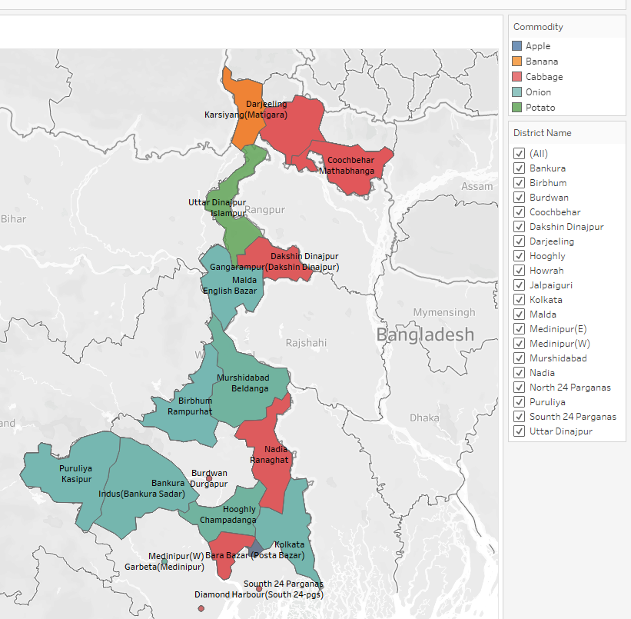
Data Understanding

Slide 13
Data Cleansing
Tableau Prep Build is used to clean data.
Excluded State for zero variance and Grade for near zero variance.
Renamed features.
Price date was in text and changed to date-time format.

Slide 14
Visualisations and Analysis

Slide 15
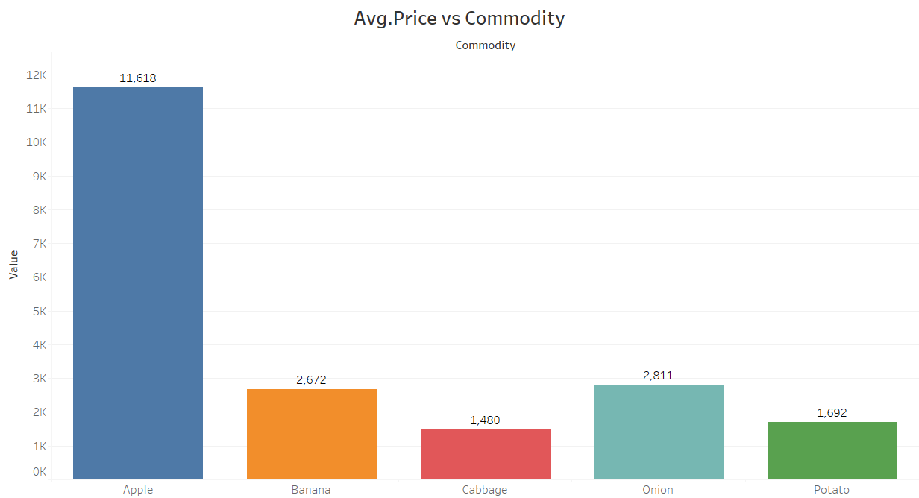
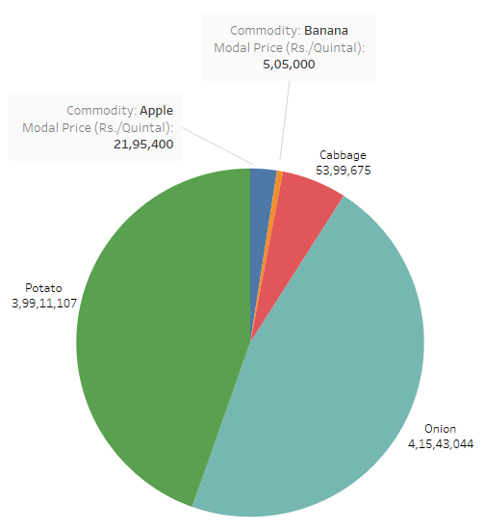
Price Analysis

Slide 16
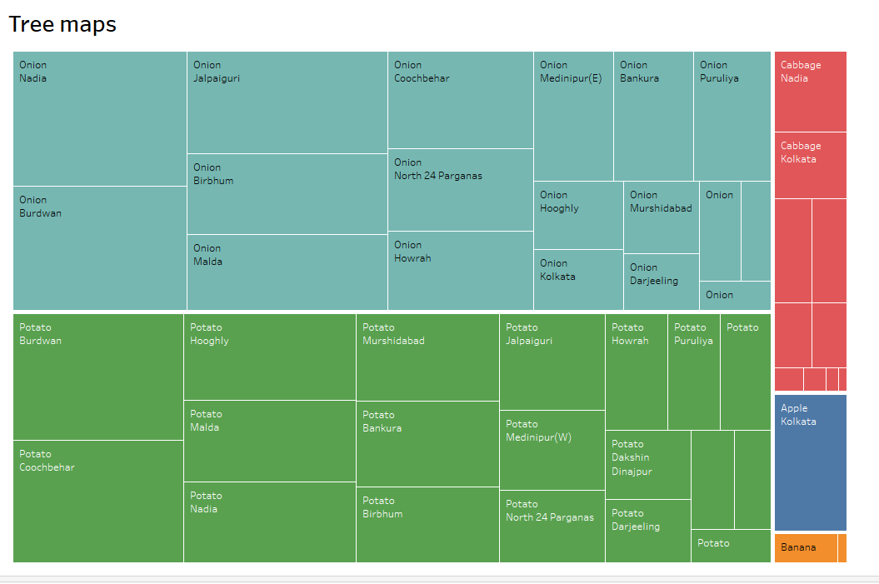
Commodities, District and Prices based Tree-Map

Slide 17
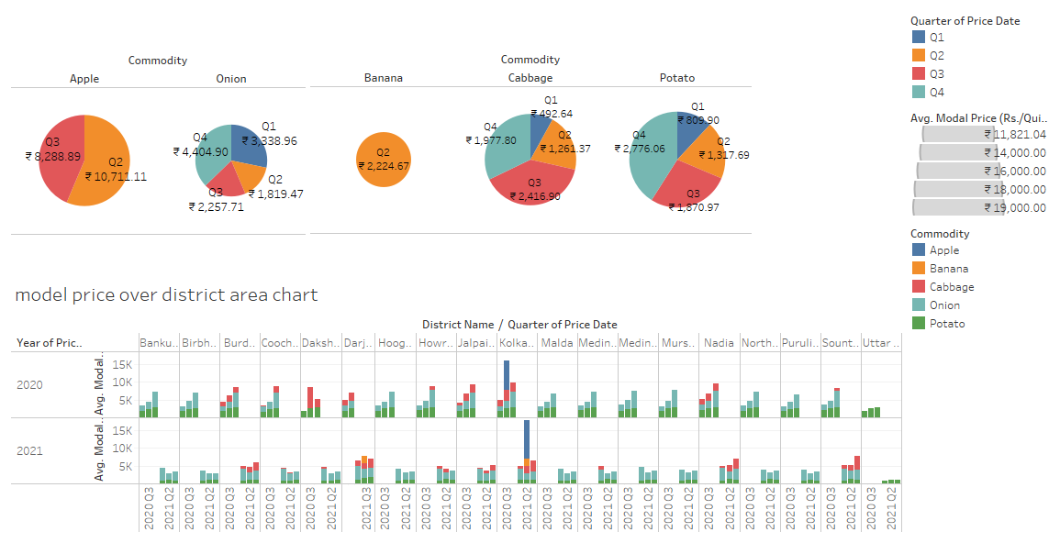
District vs. Modal Price
Commodities Banana & Apple shows highest Avg. modal price over Quarter 2, for Cabbage it is Quarter 3, and for Onion and Potatoes Quarter 4.
Every commodities showing same pattern of modal price variation over each district for different quarters of 2020 &2021

Slide 18
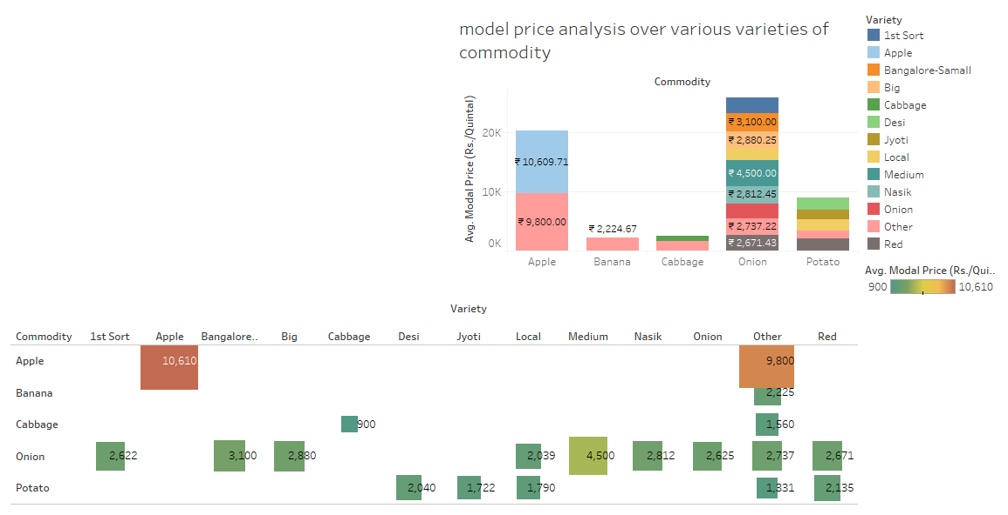
Variety Vs. Modal Price
Plot indicating each commodities and average modal prices variations over its various varieties.
Apple there have 2 varieties. In which Apple having highest prices.
Banana there have only one variety available.
Cabbage have 2 varieties. Other variety of cabbage having highest price.
Onion have 9 varieties. Medium variety have the highest average price.
Among 5 varieties of potato ‘Red’ variety have the highest average price.

Slide 19
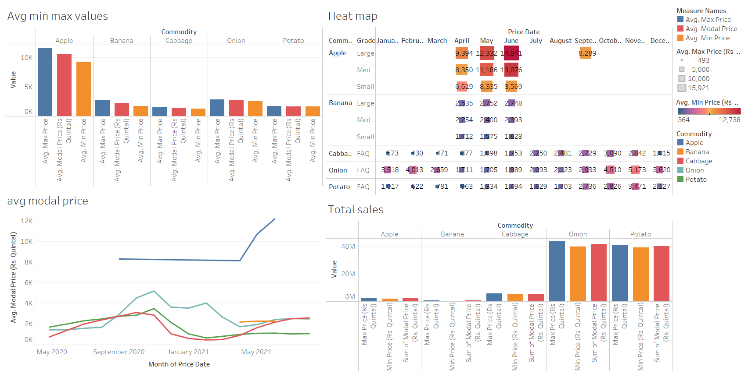
Monthly Modal Price

Slide 20
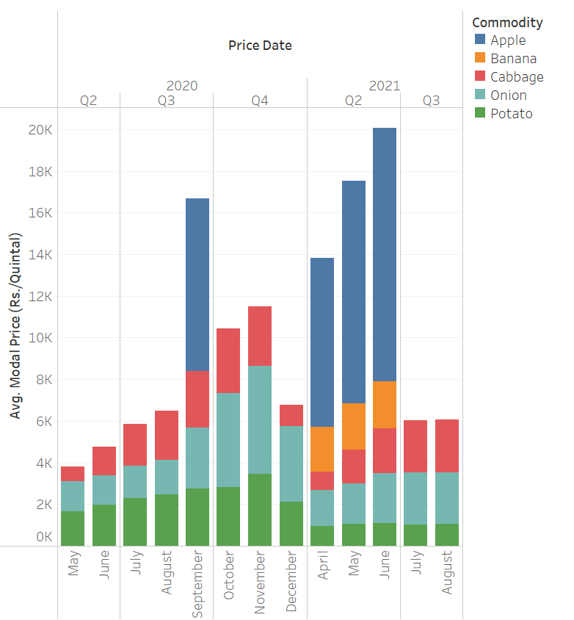
Quarterly price of Commodities
Overall, the prices of commodities are higher in Sep 2020, Apr 2021, May 2021 and June 2021, that is mostly because in these 4 months we have the data for Apple.
If we ignore the prices of Apple, then overall the prices tend to start increasing from quarter 2 of the year and go to maximum in quarter 4 of the year and and then further start increasing.
For bananas, we have the data from April, May and June 2021, which has an increasing trend over the months.

Slide 21
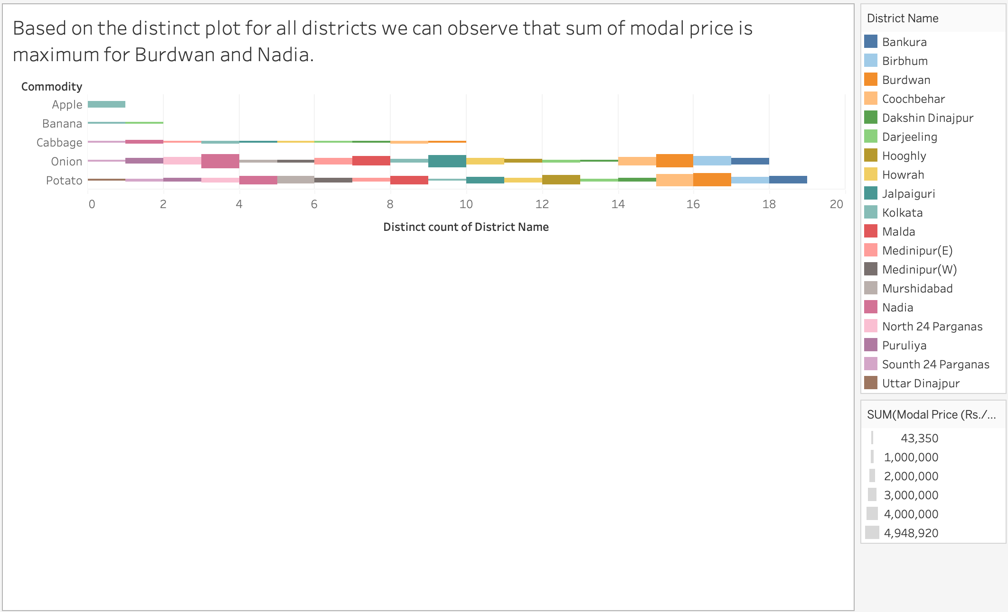
Districts wise Sum of Modal Price for Commodities

Slide 22
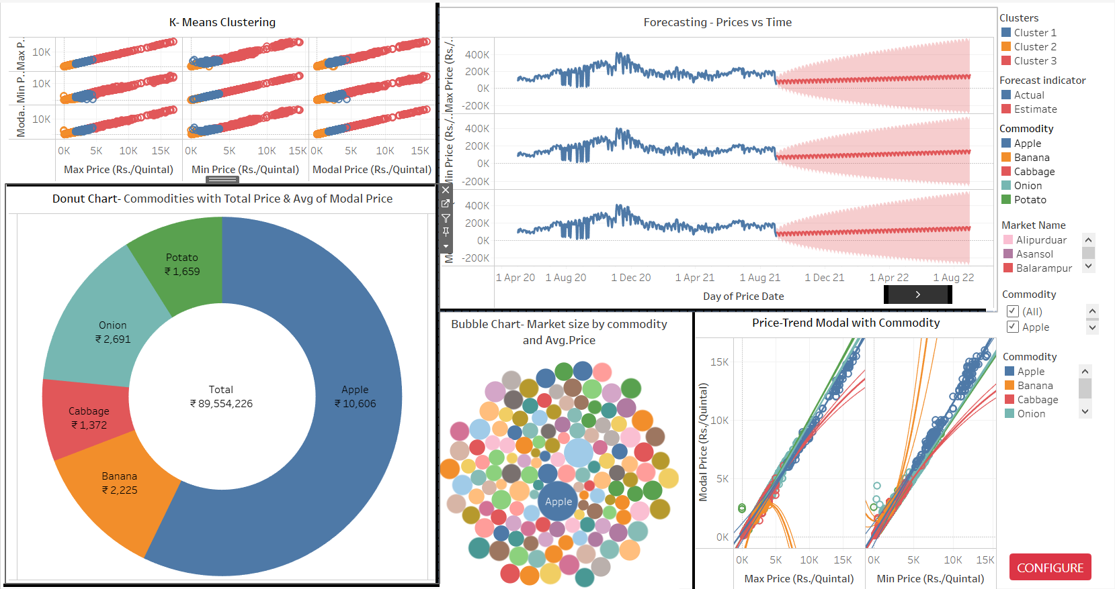
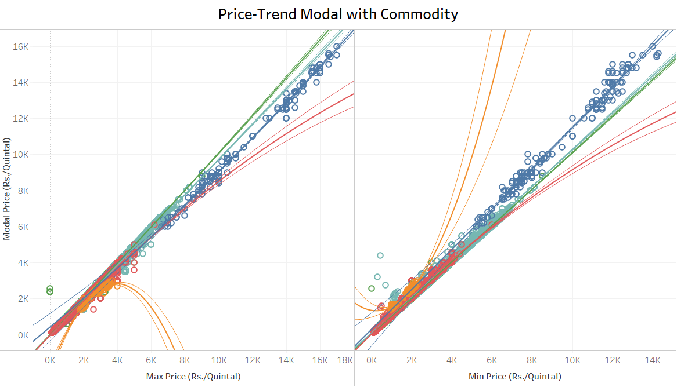
Trend Model
With a very low p=0.0045 value R squared= 0.82 we can say that the mode is statistically significant.

Slide 23
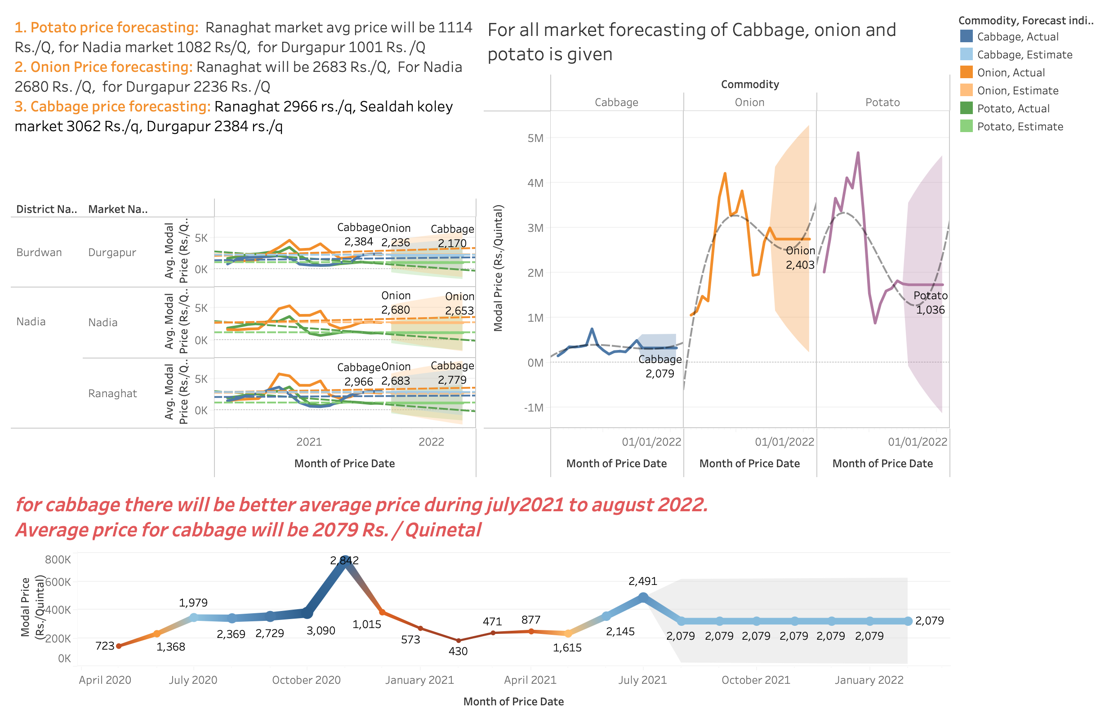
Modal Price Forecasting for Commodities

Slide 24
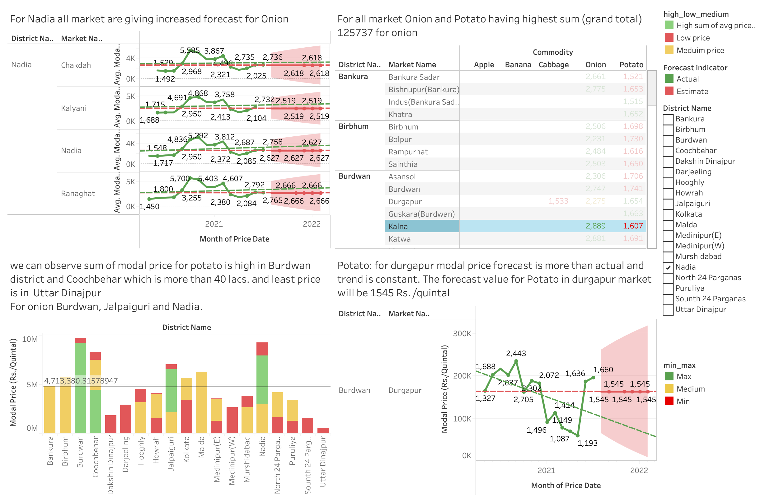
Forecasting for specific Market and District

Slide 25
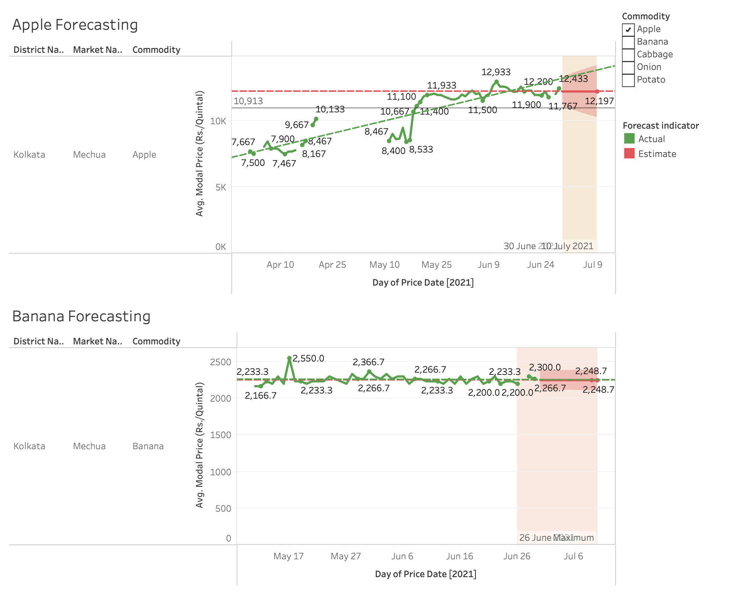
Apple and Banana Forecasting

Slide 26

Outputs

Slide 27
Conclusions
In this work, multiple dashboards and visualisations have been made.
Various Inferences for modal price with multiple dimensions have been given.
Forecasting for each commodities are presented and suggestions have been made for future business perception in various locations of west Bengal.
This project will help agriculture industry to adopt cutting edge data analytical techniques to maximize agricultural productivity and minimize crop loss due to various factors.
We would like to emphasize that more sophisticated and state of the art statistical techniques can be used utilized to this domain to bring out better forecasting and prediction in future.
We conclude that Onion of Variety Nasik has very highest sale price also high in demand and Apple has highest price but has seasonal demand.
For Onion and Potato Burdwana and Nadia district giving increased forecasting of modal price.
On the other hand, Cabbage will be 3000 rs./quintal in Kolakata sealdah koley market also second best will be Nadia Ranaghat market with 2740 rs./quintal. Apart from these commodities Banana is having forecasting of 2248 rs/quintal in Mechau market.
Outputs of
Universal Sentence Encoder:

Slide 28

Future Scope
This project will help agriculture industry to adopt cutting edge data analytical techniques to maximize agricultural productivity and minimize crop loss due to various factors.
We would like to emphasize that more sophisticated and state of the art statistical techniques can be used utilized to this domain to bring out better forecasting and prediction in future.

Slide 29
Thank You !

